Slide 1

Spring 2025
操作系统
宋 红

Slide 2
RPC (Remote Procedure Call)

Slide 3
RPC
What is RPC?
远程过程调用
Why use RPC?
解决分布式系统中，服务之间的调用问题
远程调用时，要能够像本地调用一样方便，让调用者感知不到远程调用的逻辑
How to implement RPC?

Slide 4
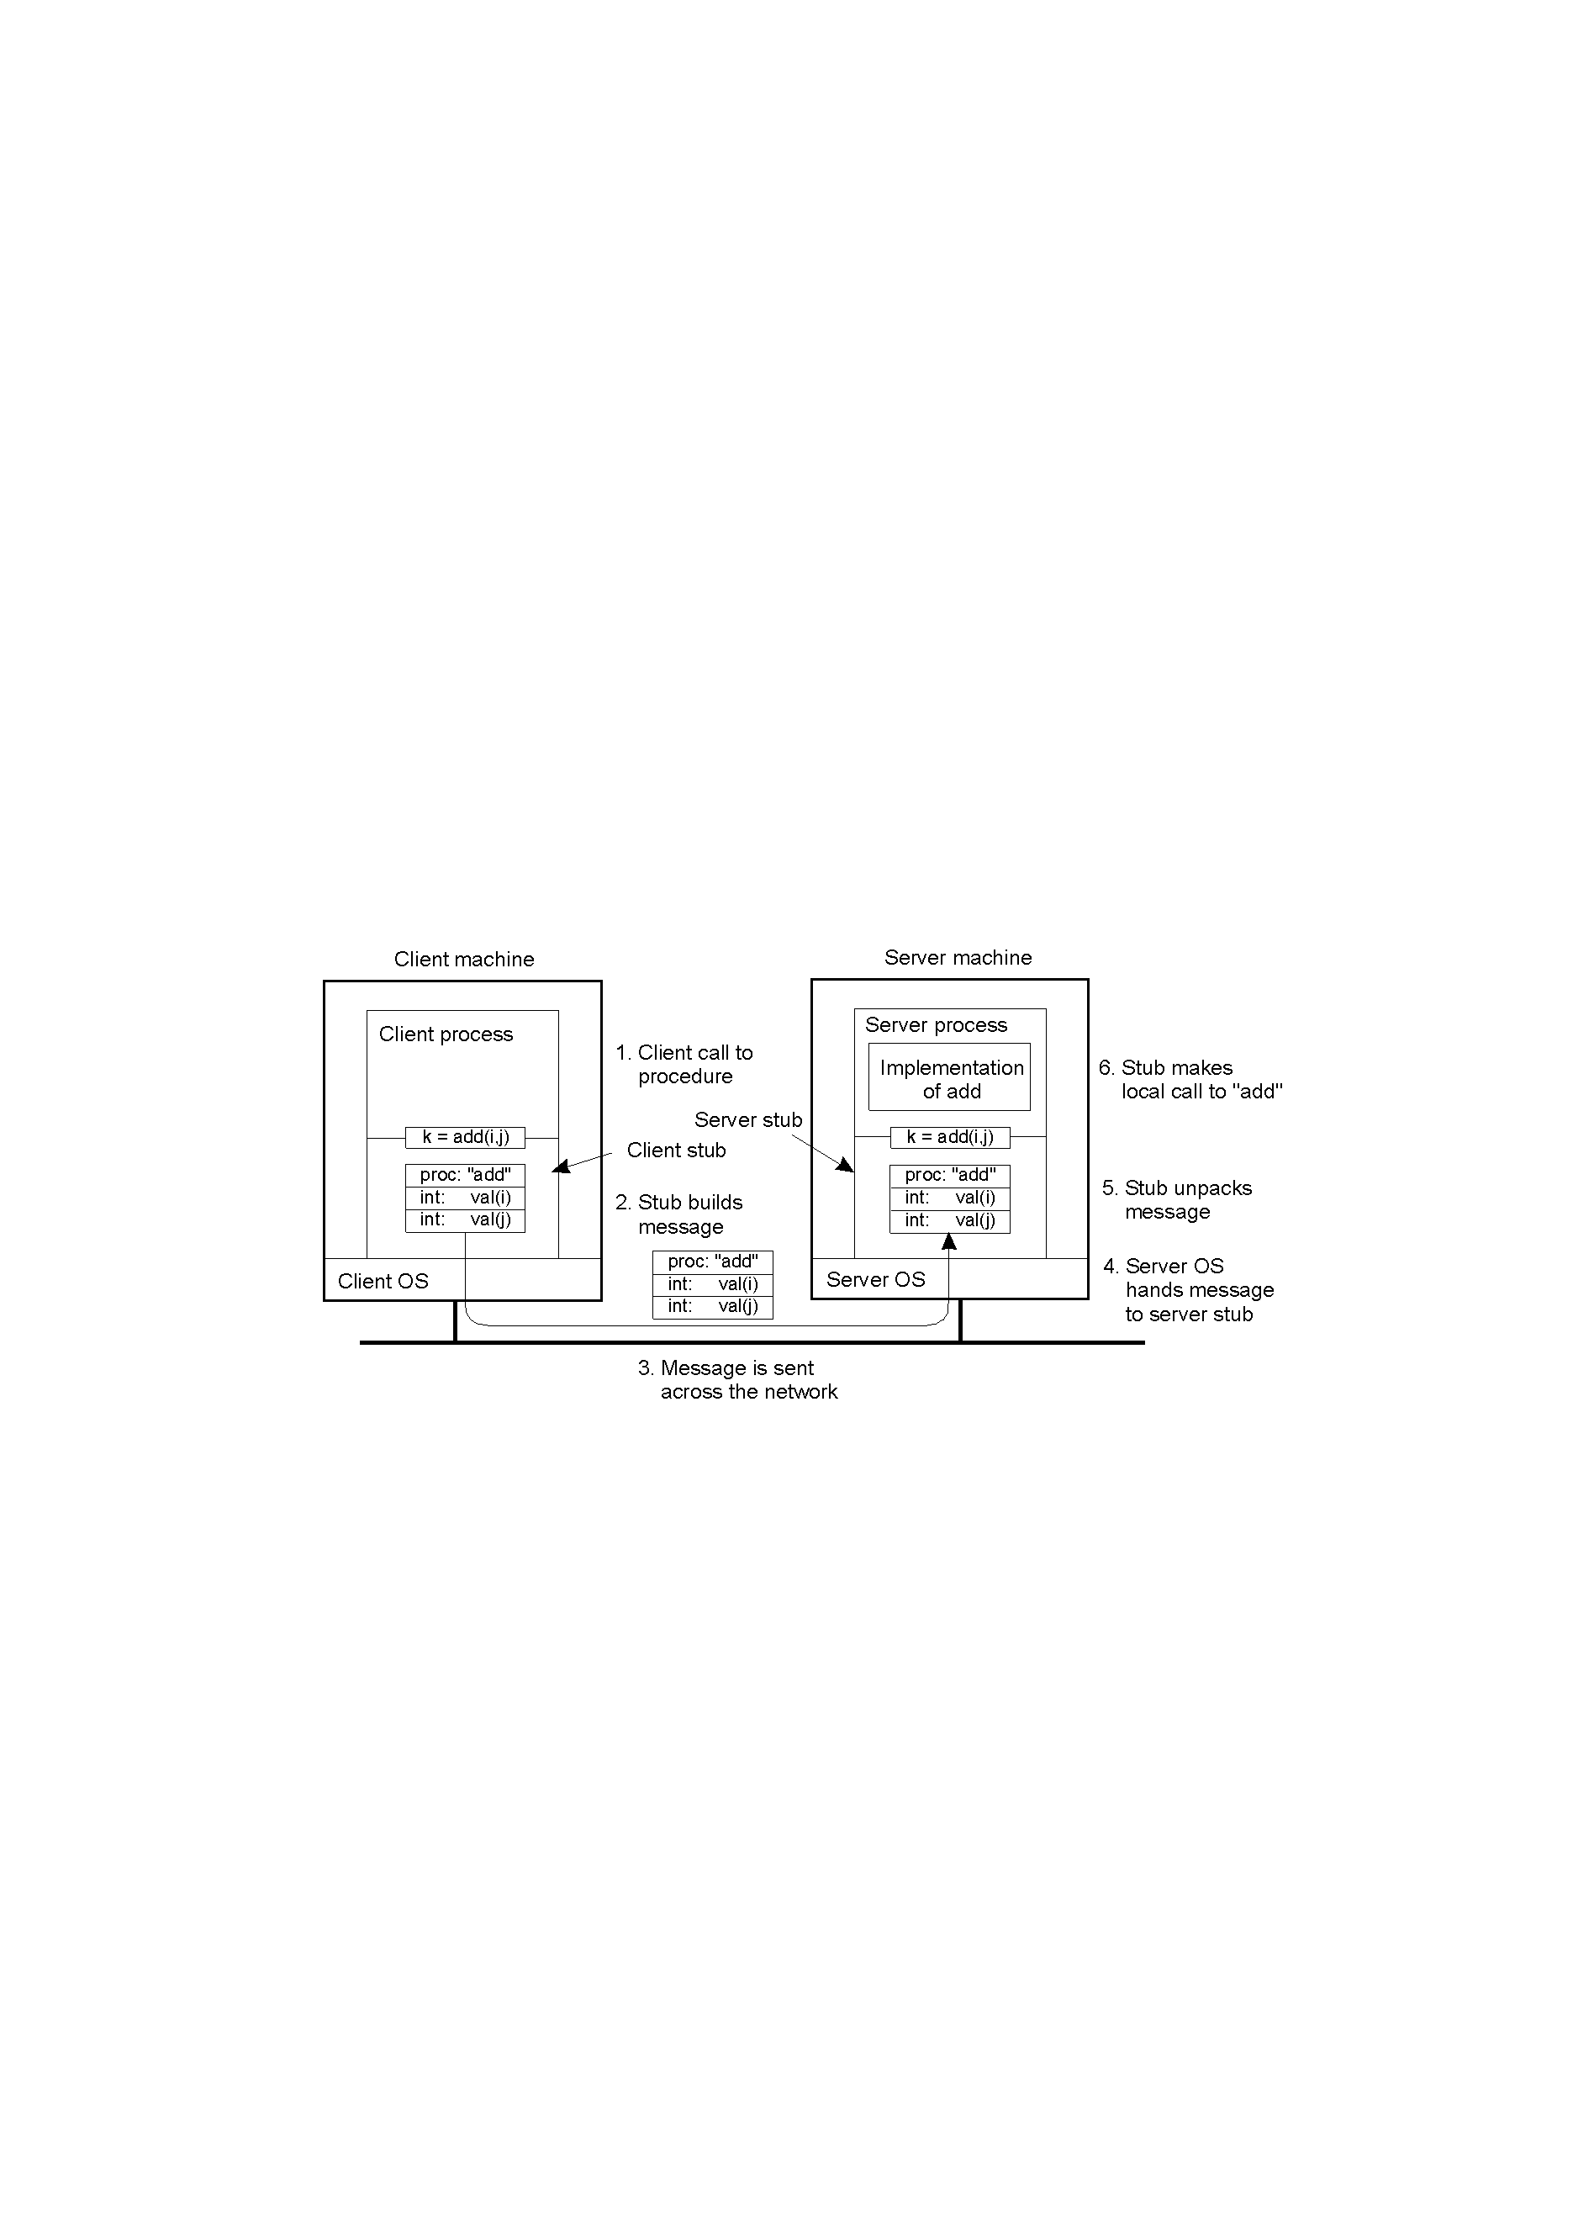
RPC(1)
RPC通信

Slide 5
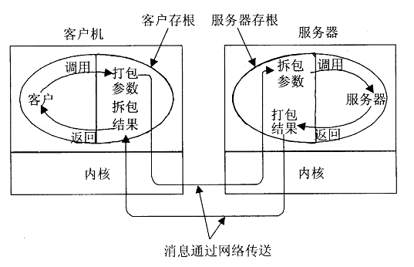
RPC(2)
RPC的步骤
1
5
4
10
6
2
9
3
7
8

Slide 6
RPC(3)
Client Stub
Piece of code responsible for proxying the remote call as a local call , and packaging the call up as a message.
does not ask the operating system to give it data
packs the parameters into a message
requests that message to be sent to the server
following the call to send, the client stub calls receive, blocking itself until the reply comes back

Slide 7
RPC(4)
Server Stub
Piece of code responsible for unpacking the message on the server, and invoking the actual server-side, application-level implementation.
the server stub calls receive, blocking itself until the request comes back
unpacks the parameters from a message
Server is written as a standard procedure
Stubs take care of packaging arguments and sending messages

Slide 8
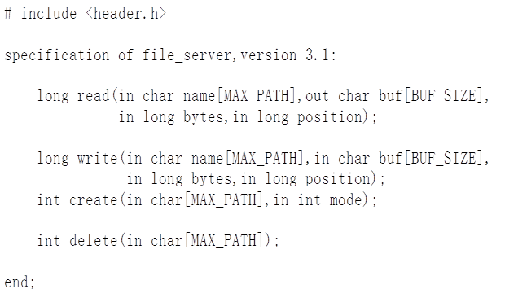
RPC(5)
Interface Definition Language (IDL)
Stub compiler generates stub automatically from specifications in an IDL

Slide 9
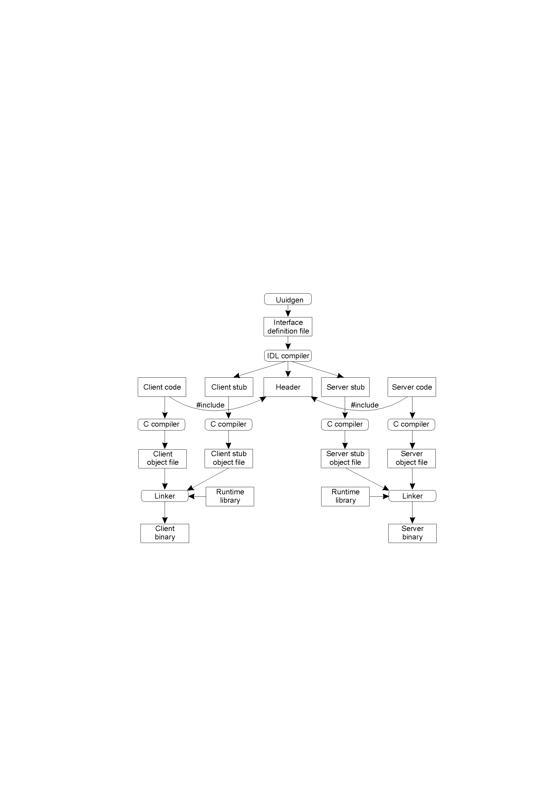
RPC(6)
Writing a Client and a Server

Slide 10
RPC(7)
A UUID (universally unique identifier) ensures that interfaces are immutable.
IDL is the glue that holds everything together.
Three files output by the IDL compiler.
A header file
e.g., interface.h, in C terms.
The client stub.
The server stub.

Slide 11
RPC(8)
Binding a Client to a Server
Server location is done in two steps.
Locate the server’s machine.
Locate the server (process end point/port) on that machine.
How does a client locate a server?
Use Bindings
Binding: the RPC system can automatically locate the correct server, and subsequently set up the communication between client and server software

Slide 12
RPC(9)
The steps of binding
Server
Export server interface during initialization
Send name, version no, unique identifier, handle (address) to binder
Client
Look up
Binding/Invocation
Binder
Register/Cancel
Server

Slide 13
RPC(10)
Client
First RPC: send message to binder to import server interface
Binder
Check to see if server has exported interface
Return handle and unique identifier to client
Example
计算阶乘的RPC实例开发过程

Slide 14
RPC(11)
1. 定义接口 (得到RpcFact.idl文件)
创建一个.idl文件, 为应用程序的远程函数定义接口
//File: RpcFact.idl
//interface header
[
uuid (C16F6562-520D-11D0-B338-444553540000),
/*universally unique identifier，唯一识别这个接口，它可让服务器用来注册接口，以使客户机可以定位这个特殊接口。uuid由5位数字组成，可以用Microsoft的uuidgen.exe来得到它*/

Slide 15
RPC(12)
version (1.0), /*指定版本号，那么在同一个网络上就可以同时拥有一个RPC接口的不同版本*/
endpoint(“ncalrpc: [myFactorial]”) /*接口的端点，它给出了将会使用的网络协议的类型和用来接收接口的请求的地址和端口，ncalrpc 表示Local procedure call*/
]
/*interface text, 指定了组成这个接口的函数, 函数类型不支持int 和void* */
interface rpcfactorial
{
long RpcFactorial([in] long nVal); // [ ]的部分表示属性
}
// end File RpcFact.idl

Slide 16
RPC(13)
2. 应用程序属性配置文件 (得到RpcFact.acf文件)
.acf文件用来指定应用程序的选项，这些属性告诉client stub如何对接口请求的绑定进行处理。
// RpcFact.acf
[
auto_handle // 相关属性
]
interface rpcfactorial
{
}
// end File RpcFact.acf

Slide 17
RPC(14)
3. 用MIDL编译器编译RpcFact.idl文件
midl.exe /c_text /ms_text /app_config RpcFact.idl
经过编译之后，会生成下列文件
RpcFact.h
RpcFact_s.c
RpcFact_c.c

Slide 18
RPC(15)
4. 开发RPC服务器
定义好了一个接口之后, 需要创建一个响应接口请求的进程, 执行请求的操作并返回所有结果给client. 这些任务由RPC服务器来完成.
(1) 执行计算的过程
本例中就是阶乘函数的实现
//File: RpcFact.c
#include <windows.h>
#include “RpcFact.h” // 用MIDL编译器生成

Slide 19
RPC(16)
long Factorial (long nVal)
{
long nResult = 1;
for (; nVal>0; nVal--)
nResult *= nVal;
return nResult;
}
// end File RpcFact.c

Slide 20
RPC(17)
(2) RPC服务器实体
使RpcFact.c真正对RPC有用的工作是在服务器存根(RpcFacts.c)中实现的，实体内的代码负责建立RPC接口的绑定，并用名称服务程序来注册它们以及侦听RPC请求。
// File: RpcFacts.c
#include <windows.h>
#include <iostream.h>
#include <rpc.h>
#include “RpcFact.h”
#include “memstub.h” //实现RPC函数的存储分配

Slide 21
RPC(18)
main()
{
RPC_BINDING_VECTOR* bindVector;
RPC_STATUS lRetVal;
/*注册所有可行的协议序列, 所支持的协议由在RpcFact.idl的端点定义中的字符串指定*/
// 参数rpcfactorial_v1_0_s_ifspec定义在RpcFact.h中, 由MIDL编译生成
if (lRetVal = RpcServerUseAllProtseqsIf(1, rpcfactorial_v1_0_s_ifspec, NULL))
{
cout<<”Error in RpcServerUseAllProtseqsIf”<<lRetVal<<endl;
return 1;
}

Slide 22
RPC(19)
// 注册所支持的接口
if (RpcServerRegisterIf(rpcfactorial_v1_0_s_ifspec, NULL, NULL))
{
cout<<”Error in RpcServerRegister”<<endl;
return 1;
}
// 将接口的绑定输出到名称服务程序
if (RpcServerInqBindings(&bindVector))
{
cout<<”Error in RpcServerInqBindings”<<endl;
return 1;
}

Slide 23
RPC(20)
if(RpcServerBindingExport(RPC_C_NS_SYNTAX _DEFAULT, (UCHAR*)”/.: /autorpc”, pcfactorial_v1_0_s_ifspec, bindVector, NULL))
{
cout<<”Error in RpcServerBidingExport”<<endl;
return 1;
}
// 侦听RPC请求
cout<<”Calling RpcServerListen”<<endl;
if (RpcServerListen(1, 5, FALSE))
{

Slide 24
RPC(21)
cout<<”Error in RpcServerListen”<<endl;
return 1;
}
return 0;
}// end main
// end File RpcFacts.c
// File: memstub.h
// 以下两个函数在RpcFact.h中已经声明
void __RPC_FAR * __RPC_USER MIDL_user_allocate(size_t len)

Slide 25
RPC(22)
{ return (new (unsigned char [len]));
}
void __RPC_USER MIDL_user_free( void __RPC_FAR* ptr)
{ delete ptr; }
// end File memstub.h
(3) 建立服务器
建立服务器时需要确保连接server stub函数(即RpcFact_s.c)编译后的.obj文件， 此外还得添加两个RPC运行库(rpcns4.lib和rpcrt4.lib)。

Slide 26
RPC(23)
5. 开发RPC客户端
// File: RpcFactc.c
#include <windows.h>
#include <iostream.h>
#include <rpc.h>
#include <stdlib.h>
#include “RpcFact.h”
#include “memstub.h”

Slide 27
RPC(24)
main()
{
long nVal;
cout<<”Calling RPC Factorial”<<endl;
nVal = RpcFactorial(5);
cout<<”RpcFact returns: “<<nVal<<endl;
return 0;
}
// end File RpcFactc.c

